Slide 1


R Workshop
24/02/2026
By: Joaquin Villar, Roshan Prabhu

Slide 2
Table of Contents
What is R
Why R
Basics of R
1
Visualisation
Making a Linear Regression Model
4
2
5
3

Slide 3
01
What is R?

Slide 4

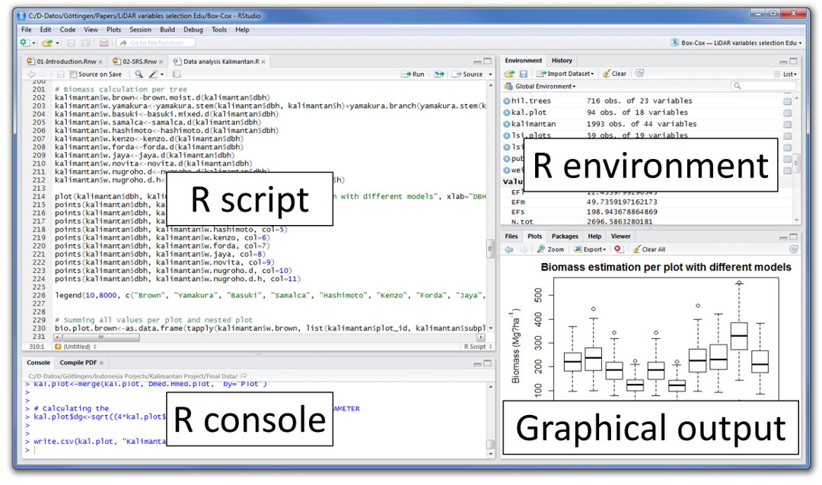
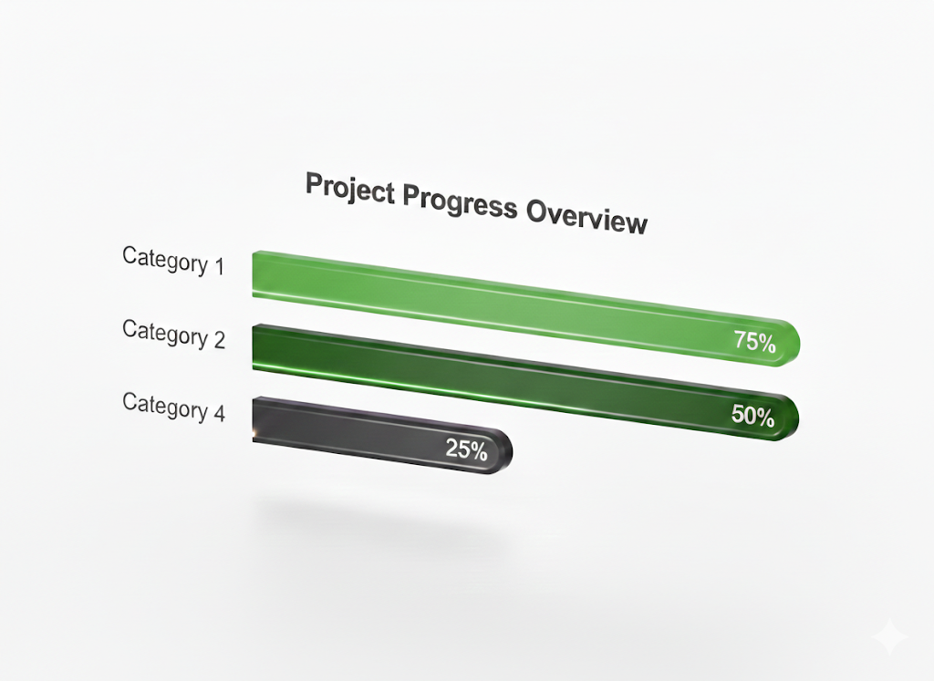
What is R?
Open-source & Powerful ecosystem
Initially created for statisticians -> but now used by
Data scientists
Researchers
Analysts
AI & ML developers
Notes:
R is a programming language for:
Statistics
Data Analysis
Data Visualization
—------------------
Python is general-purpose; R is statistics-first.
It shines in:
Academic research
Data exploration
Statistical modelling
Visualization
In industry:
Used in healthcare, finance, sports analytics, social sciences.

Slide 5
Why R?
Specialized for Statistics: Unlike general-purpose languages, R was built specifically for data analysis and statistical computing.
Superior Data Visualisation: Includes powerful libraries like ggplot2 for creating publication-quality graphics.
Comprehensive Ecosystem: Access to over 18,000 packages via CRAN for everything from econometrics to machine learning.
Data Handling: Native support for data frames and vectorized operations makes cleaning and manipulating data highly efficient
Notes:
R is a programming language for:
Statistics
Data Analysis
Data Visualization
—------------------
Python is general-purpose; R is statistics-first.
It shines in:
Academic research
Data exploration
Statistical modelling
Visualization
In industry:
Used in healthcare, finance, sports analytics, social sciences.

Slide 6
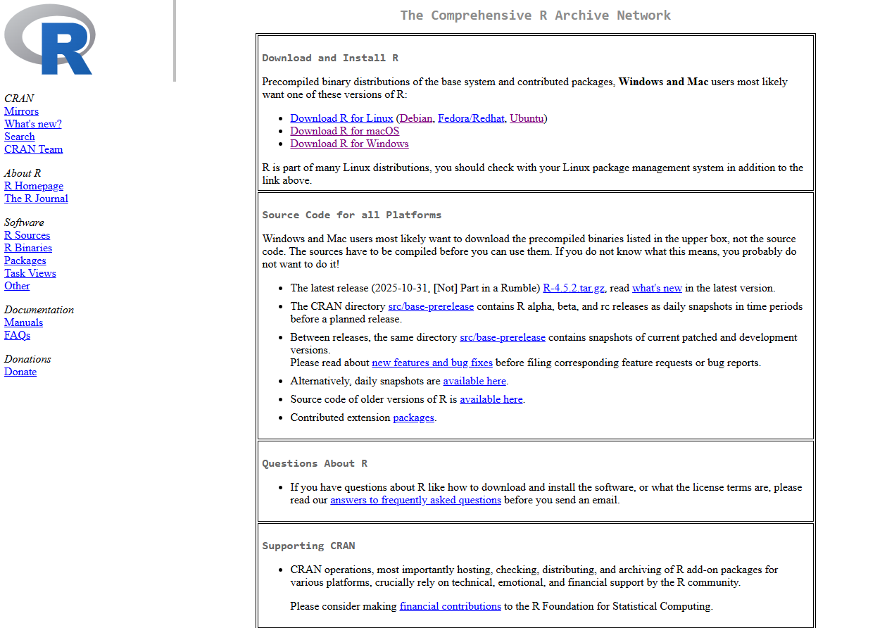
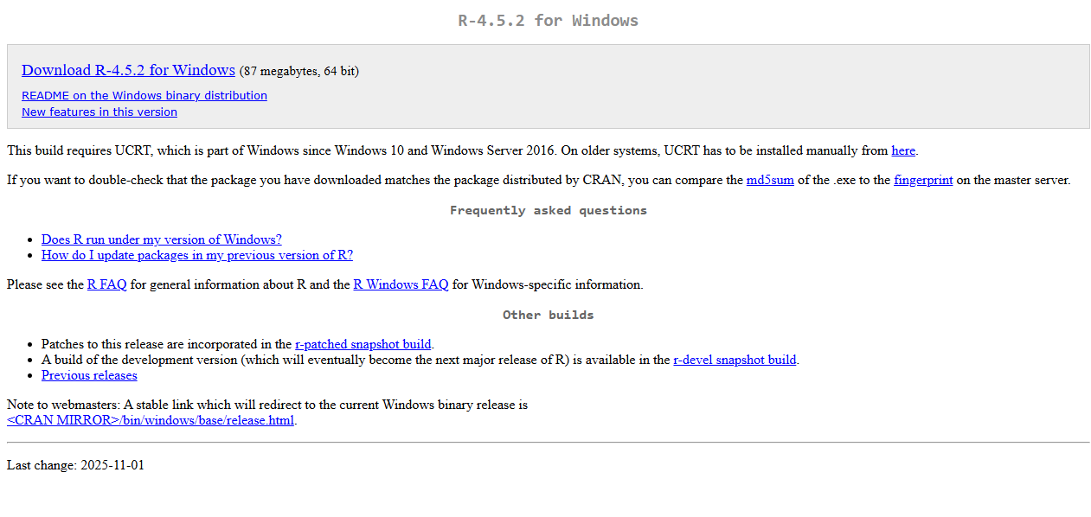
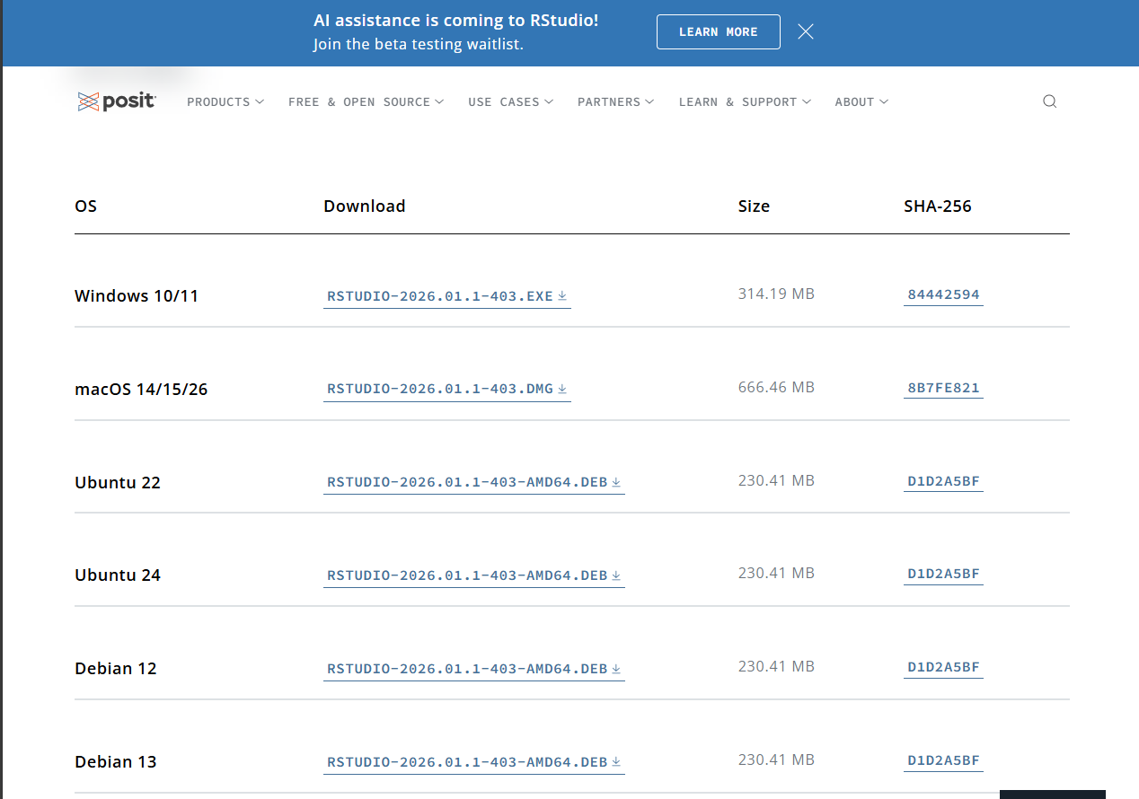
How to download R
Download R: https://cran.r-project.org/bin/windows/base/
R Studio (IDE): https://posit.co/download/rstudio-desktop/

Slide 7
02
Basics of R

Slide 8
Basics of R
1
2
3
Creating Dataframes
Accessing the Data
Data Manipulation
4
5
Data Analysis
Data Visualization

Slide 9
Dataframes
hours_studied | attendance | exam_score
2 | 60 | 50
4 | 75 | 65
5 | 80 | 70
3 | 65 | 55
6 | 90 | 85

Slide 10
Viewing / Accessing Data
Viewing
print()
head()
tail()
str()
summary()
Accessing
dataFrame$columnName
dataFrame[rows, columns]
Access by name
Access by row & col
Important: R starts indexing with 1, not 0
Notes:
str() - string value of a field

Slide 11
Data Manipulation
Filtering Data
Selecting Rows
Selecting Cols
my_data[my_data$col_name > value, ]
my_data[,c(“col1”, “col2”)]
Using Subset
df_name <- subset(my_data,col_name> value)
Notes:
Filter data to get a subset of itv hbya

Slide 12
Data Manipulation
Sorting Data
my_data[order(my_data$col1), ]
Original Data
After Data
name | col1 | age
Anna | 75 | 20
Ben | 60 | 22
Chris | 90 | 19
Dina | 80 | 21
name | col1 | age
Ben | 60 | 22
Anna | 75 | 20
Dina | 80 | 21
Chris | 90 | 19
Notes:
Filter data to get a subset of itv hbya

Slide 13
Data Manipulation
Sorting Data
my_data[order(my_data$col1,decreasing=TRUE), ]
Original Data
After Data
name | col1 | age
Anna | 75 | 20
Ben | 60 | 22
Chris | 90 | 19
Dina | 80 | 21
name | col1 | age
Chris | 90 | 19
Dina | 80 | 21
Anna | 75 | 20
Ben | 60 | 22
Notes:
Filter data to get a subset of itv hbya

Slide 14
Data Manipulation
Adding Columns to dataframe
Add Columns
my_data$new_col_name <- c(...,...,...,...)
my_data$new_col_name <- my_data$col1 + my_data$col2
Add Rows
my_data[nrow(my_data) + 1] <- c(“value”, value,...)
Notes:
Filter data to get a subset of itv hbya

Slide 15
Data Manipulation
Adding Conditions
Python
R
Basic if else:
if …
if..
if ..
else..
else…
elseif …
else …
if …
if..
if ..
else..
else…
elseif …
else …
ifelse(condition, value, value)
Notes:
Filter data to get a subset of itv hbya

Slide 16
Data Manipulation
Adding Conditions
Nested if else:
ifelse(condition, value, ifelse(condition, value, ifelse(condition, value, value)))
Eg.
ifelse(weather$temperature >= 30, "Hot",
ifelse(weather$temperature >= 20, "Warm",
ifelse(weather$temperature >= 10, "Cool", "Cold")))
Notes:
Using this knowledge, you can now add

Slide 17
Recap
Creating Dataframes
Access/View the Data
Filter Data
Sort Data
Add new data to existing frame
Add conditions to format data

Slide 18
Challenges
Main Dataset
students <- data.frame(
hours_studied = c(2,4,5,3,6,8,7,1,9,4),
attendance = c(60,75,80,65,90,95,85,50,100,70),
exam_score = c(50,65,70,55,85,92,88,40,95,68)
)

Slide 19
Challenges
Questions
Find students who studied more than 6 hours.
Find students with attendance below 70%.
Find students who:
Studied more than 5 hours
AND scored above 80
Create a column called
score_per_hour = exam_score / hours_studied
grade where “A” if score ≥ 85, “B” if score 70–84, “C” if score < 70
Sort students by highest exam score.
Sort by lowest attendance.

Slide 20
03
Visualisation

Slide 21
Data Analysis
Descriptive Stats
Gives you values from a col
mean()
sd()
cor()
median()
sum()

Slide 22
Data Visualisation
Frequency Tables: Use table(dataframe$column)
to quickly see the distribution of categorical data.
The Power of ggplot2: The gold standard for R visualization.
Syntax: ggplot (data, aes(x, y)) + geom_type().
Scatter Plots: Use geom_point() to see relationships between variables.
Histograms: Use geom_histogram() to view the distribution of a single variable.
Descriptive Stats Visualised:
Box Plots: Use geom_boxplot() to identify outliers and quartiles.

Slide 23
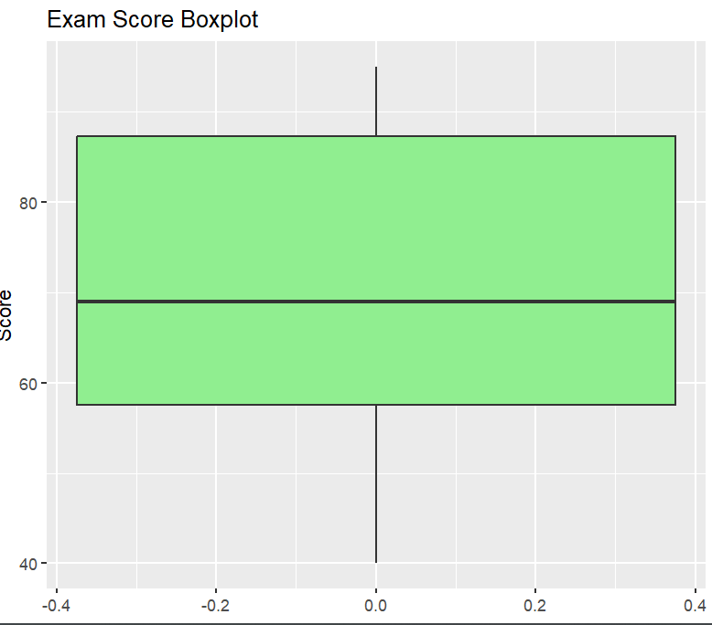
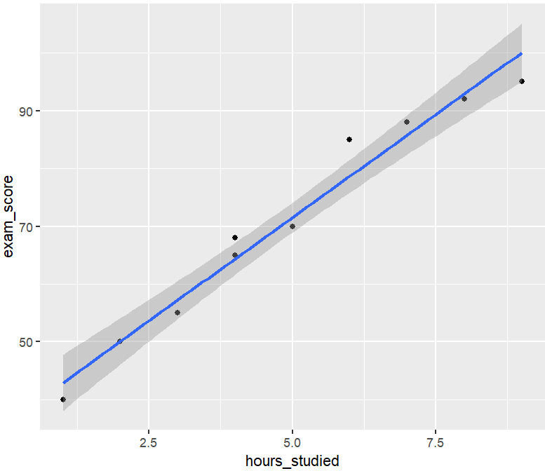
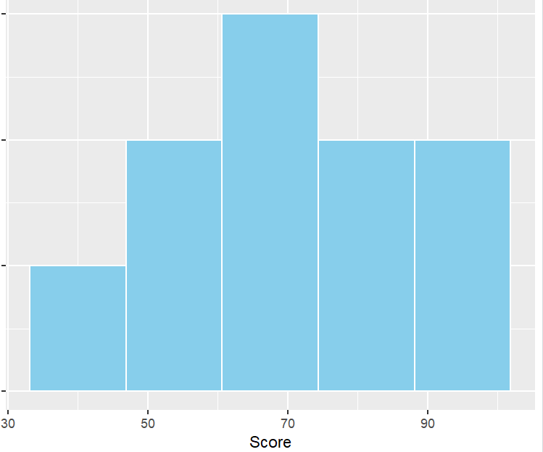
Data Visualisation

Slide 24
04
Making a Model

Slide 25
Linear Regression Model
The lm() Function: Use model <- lm(y ~ x, data = dataset) where y is the dependent variable and x is the independent variable.
Practical Example:
fit <- lm(exam_score ~ hours_studied, data = students)
Checking the Model: Use summary(fit) to see the R-squared value and P-values.
Plotting the Trend: Use abline(fit) to add the regression line to a standard plot.

Slide 26
Challenges
Main Dataset
students <- data.frame(
hours_studied = c(2,4,5,3,6,8,7,1,9,4),
attendance = c(60,75,80,65,90,95,85,50,100,70),
exam_score = c(50,65,70,55,85,92,88,40,95,68)
)

Slide 27
Challenges
Questions
Create a scatter plot of Hours Studied vs. Exam Score using plot() or ggplot2
Fit a linear model to see if hours_studied predicts exam_score
Find the R-squared value, how much of the grade is actually explained by study time?

Slide 28
Thank You For Attending!
Any Questions?

